Slide 1

The University of Tennessee College of Education, Health, and Human Sciences CAPS Outreach Center Math and Science Upward Bound
U. S. Department of Education, Washington, DC
TRiO Programs
Sean George (Jefferson County), Lucas Bittof (Jefferson County)
Isaac Bredeson, Mentor
Dr. Ernest W. Brewer, Professor and PI/Director of CAPS
Mrs. Leigh Ann Elkins, Project Director of MSC
Justin Lee, Facilitator of Mentoring Projects
Bailee Woodall, Facilitator of Mentoring Projects

Slide 2
Study of Graphene and Silicon Heterostructures
Sean George (Jefferson County High School), Lucas Bittof (Jefferson County High School)

Slide 3
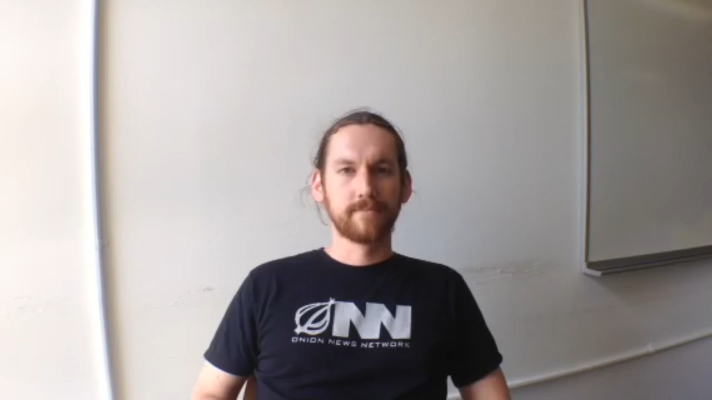
Introduction of Mentor

Slide 4
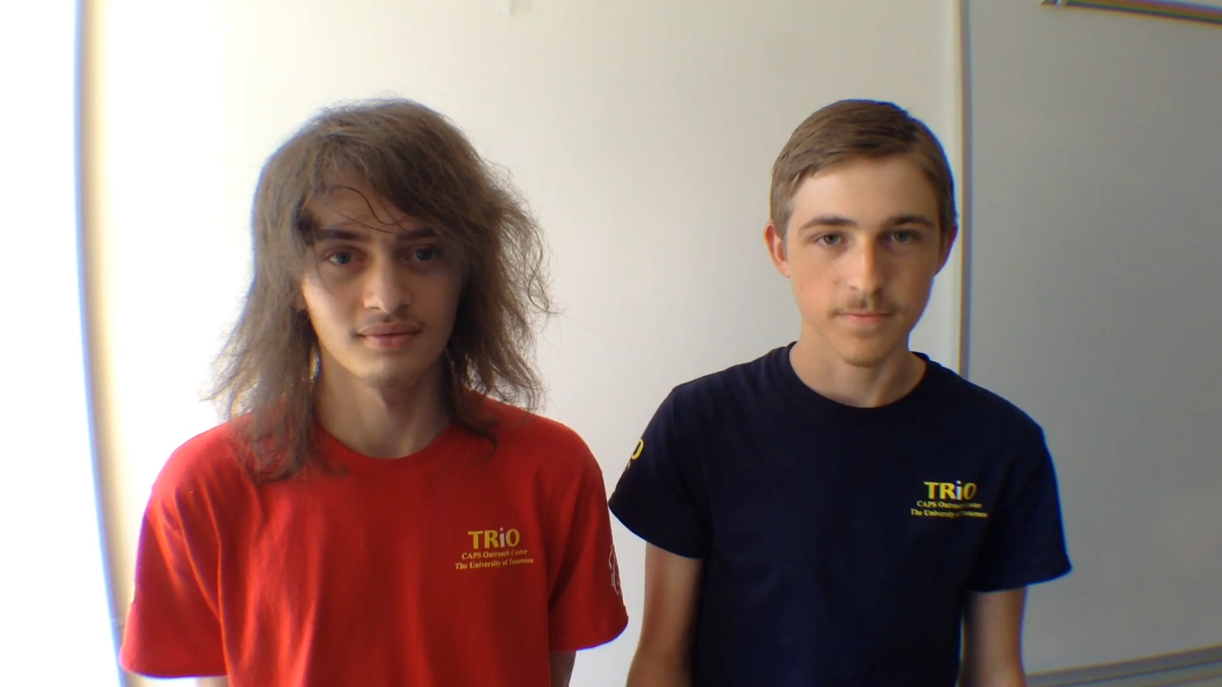
Introduction of Students

Slide 5
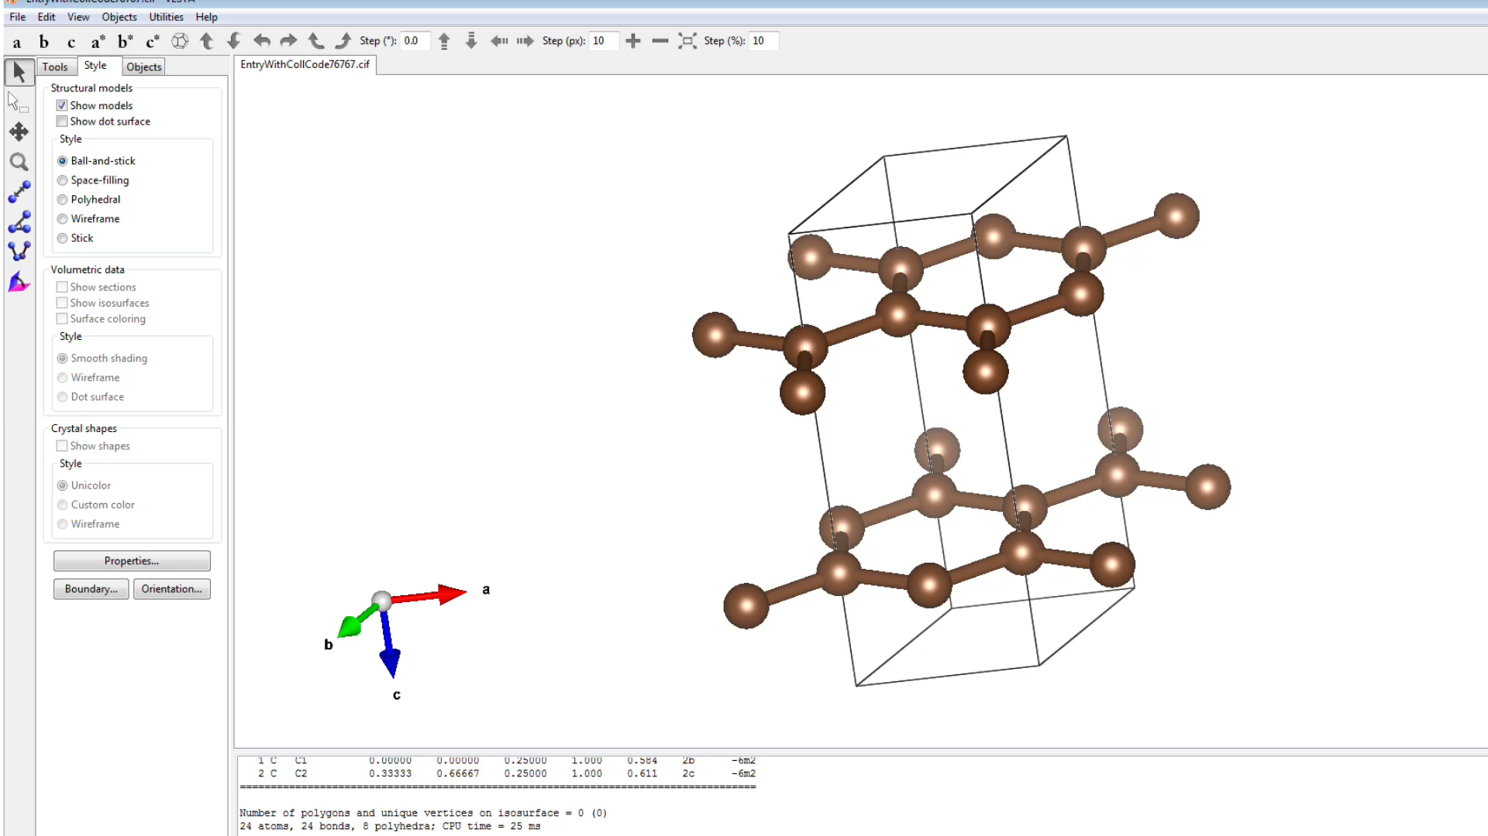
Introduction of Experiment

Slide 6
Hypothesis
We predict that the bonding energy will be lower when Graphene binds to crystalline Silicon than glassy Silicon

Slide 7
Research Meothods
Procedure:
Get graphite.cif file from ICSD Database
Convert to graphene with text editor
Convert to .vasp file using Vesta
Convert to rectangular unit cell by calculating on paper, using text editor
Generate 4x2 supercell using provided Python script
Get silicon.cif file from ICSD Database
Convert to .vasp file with Vesta
Convert to 2D face-centered layer using text editor
Generate 2x2 supercell using provided Python script

Slide 8
Research Meothods
Procedure:
Modify the unit cell lengths of graphene and silicon to be equal, such that the new lengths are in between the initial lengths of the two supercells to minimize strain.
Offset graphene by 1.5 angstroms
Use VASP to calculate energy for both supercells
Generate a series of 4 progressively more glassy silicon supercell using Python script
Combine glassy layers with graphene supercell to form a layered heterostructure, as well as graphene with the crystalline silicon
Calculate energy of combined heterostructures
Take difference in energy between heterostructures and the energy of the graphene supercell alone plus silicon supercell energy alone, the difference = binding energy.
Plot binding energy vs. ‘glassiness’

Slide 9
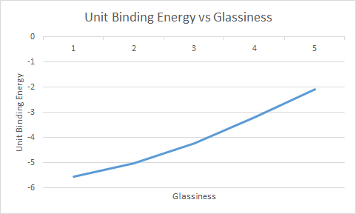
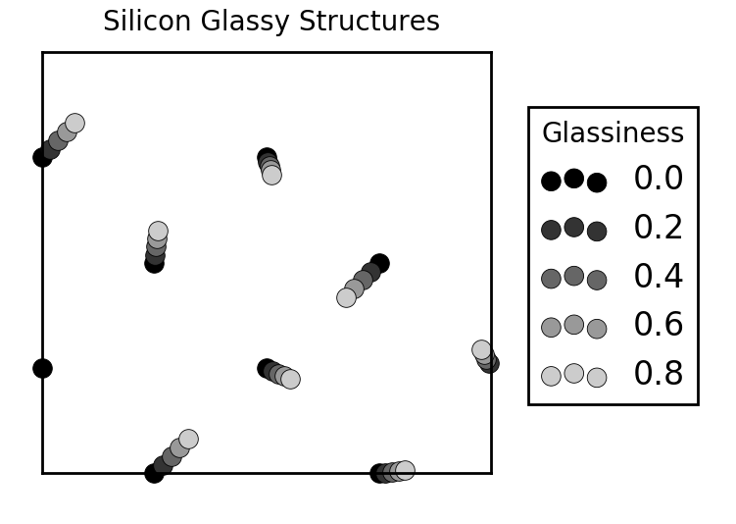
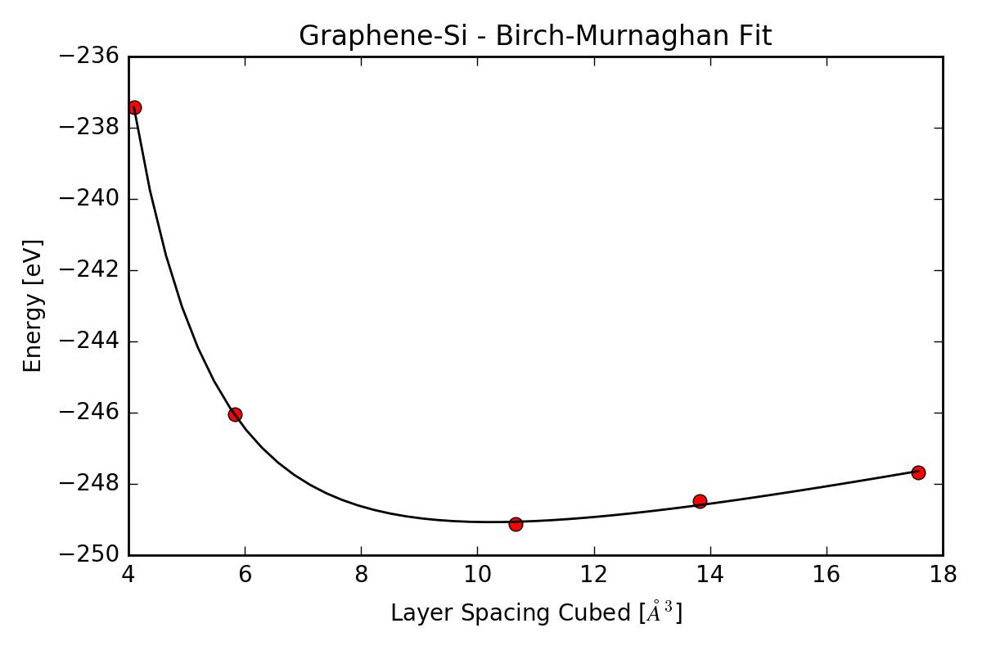
Pictures
Fig. 3: Unit Binding Energy vs Glassiness
Fig. 2: Silicon Glassy Structures
Fig. 1: Graphene-SI – Birch-Murnaghan Fit

Slide 10
Results
Energy of Graphene: -235.48285 eV
Energy of Silicon: -8.2747391 eV
Binding Energy of Crystalline Graphene and Silicon: -5.5899956 eV/angstrom^2
Binding Energy of Slightly Glassy Graphene and Silicon: -5.0589389 eV/angstrom^2
Binding Energy of More Glassy Graphene and Silicon: -4.2581974 eV/angstrom^2
Binding Energy of Mostly Glassy Graphene and Silicon: -3.2056997 eV/angstrom^2
Binding Energy of Glassy Graphene and Silicon: -2.0784606 eV/angstrom^2

Slide 11
Conclusions
The energy of the combined system of Graphene and Silicon changes very little
The Glassier the Silicon the lower the energy
The Glassier Silicon is more stable
Only the Single layer of Silicon varies in energy as it gets more Glassy
Graphene binds better to Crystalline Silicon than Glassy Silicon
It would take twice as much energy to separate Graphene from Crystalline Silicon the it would to separate Graphene from Glassy Silicon

Slide 12
References
Chem Soc Rev. 2014. Atlas of 2D Materials.
Florian Banhart, Jani Kaokoski, and Arkady V. Krasheninnikov 2011. Structural Defects in Graphene.
Graphene as a transparent electrode for amorphous silicon-based solar cells. (n.d.). Retrieved July 06, 2016, from http://scitation.aip.org/content/aip/journal/jap/117/24/10.1063/1.4923232
Two-dimensional materials and their prospects in transistor electronics. (n.d.). Retrieved July 06, 2016, from http://pubs.rsc.org/en/content/articlehtml/2015/nr/c5nr01052g
Graphene as a transparent electrode for amorphous silicon-based solar cells. (n.d.). Retrieved July 06, 2016, from http://scitation.aip.org/content/aip/journal/jap/117/24/10.1063/1.4923232\
Neutral-Color Semitransparent Organic Solar Cells with All-Graphene Electrodes. (n.d.). Retrieved July 06, 2016, from http://pubs.acs.org/doi/full/10.1021/acsnano.5b04858
This Month in Physics History. (n.d.). Retrieved July 06, 2016, from https://www.aps.org/publications/apsnews/200910/physicshistory.cfm

Slide 13
Credits
CAPS Outreach Center
The Math and Science Center
Dr. Ernest W. Brewer, Professor and PI/Director of Caps
Ms. Leigh Ann Elkins, Project Director of MSC
Justin Lee, Facilitator of Mentor Project
Bailee Woodall, Facilitator of Mentor Project
Isaac Bredeson, Mentor

